Slide 1
NFHS HEALTH DATA ANALYSIS PROJECT Source: https://data.gov.in/ Dataset: National Family Health Survey
Name: M.Harshitha
Roll No: 2211CS010365
Section: S1-54

Slide 2
Introduction
NFHS-5 (National Family Health Survey) is a nationwide survey in India covering health, population, and socio-economic indicators.
Collects data on women (15–49 yrs), men (15–54 yrs), and children to assess health and nutrition status.
Tracks key indicators like education, fertility, maternal and child health, family planning, and healthcare access.
Helps identify state-wise and regional disparities in health, education, and population trends.
Supports evidence-based policymaking and resource allocation for social and health programs.
Provides data-driven insights for improving overall public health and developmental planning.

Slide 3
Initial Analysis of the Dataset
1.Dataset Overview:
State/UT-wise NFHS-5 dataset, including urban, rural, and total categories.
Covers demographic, health, education, and socio-economic indicators for women, men, and children.
Columns include households surveyed, age-specific population, literacy, sex ratios, birth registration, mobile/bank usage, menstrual hygiene, violence, tobacco, and alcohol consumption.
2.Data Quality & Structure:
No missing or null values → ensures consistency and reliability.
Over 1,000 records across multiple states and indicators.
Standardized columns facilitate comparisons across regions.

Slide 4
Initial Analysis of the Dataset
3.Demographics & Population Insights:
Population below age 15 varies by region, reflecting age distribution differences.
Urban vs Rural: Education, literacy, and access to facilities differ significantly.
4.Education & Women Empowerment:
Female population age 6+ who ever attended school shows wide variation (e.g., urban: 82.5%, rural: 66.8%).
Indicators like mobile usage, bank account ownership, and menstrual hygiene highlight women’s empowerment levels.
5.Gender & Social Indicators:
Sex ratio and sex ratio at birth indicate regional gender disparities.
Data on spousal violence, sexual violence, and pregnancy-related physical violence provide insights into social challenges.

Slide 5
Initial Analysis of the Dataset
6.Health & Lifestyle Patterns:
Tobacco and alcohol consumption differ markedly between men and women.
Children under 5 years whose births were registered show variations in civic awareness and administration coverage.
7.Key Relationships
Education ↑ → Women empowerment ↑ (bank account & mobile usage).
Urban vs Rural: Urban areas have better education, healthcare, and facilities.
Sex ratio imbalance → Lower female literacy & higher violence.
Men consume more tobacco & alcohol, especially in rural areas.
Higher child birth registration → Better access to health & education.
Lower literacy/empowerment → Higher spousal & sexual violence.

Slide 6
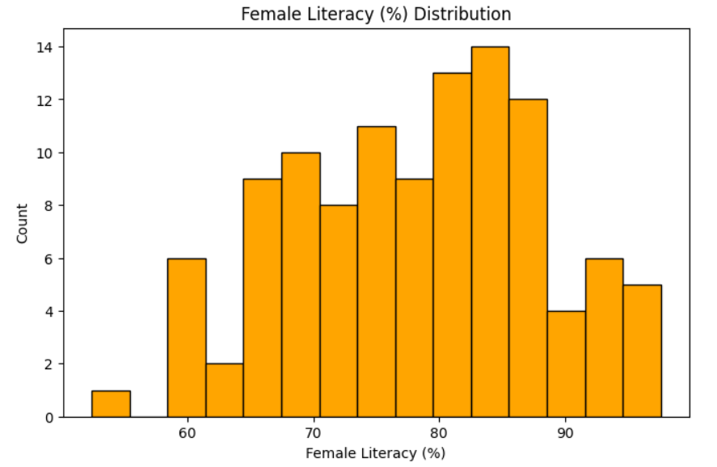
Visual Insights from Initial Analysis
1. Female Literacy (%) Distribution: Shows that most regions have female literacy rates between 70%–90%, indicating generally high literacy among women.

Slide 7
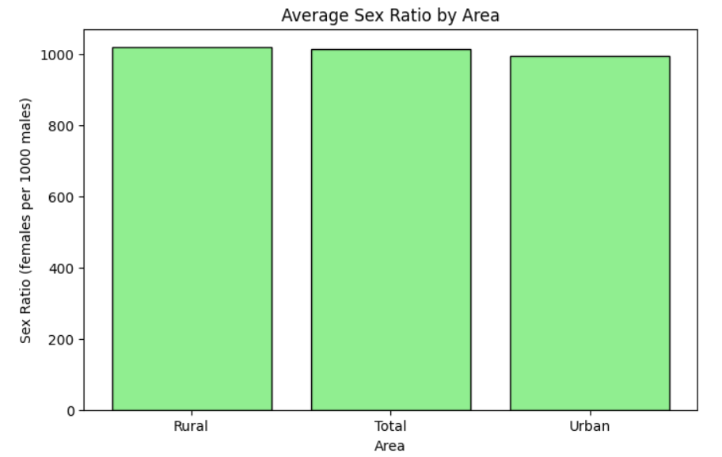
Visual Insights from Initial Analysis
2. Average Sex Ratio by Area: Sex ratio is close to 1000 females per 1000 males in all areas, slightly higher in rural regions.

Slide 8
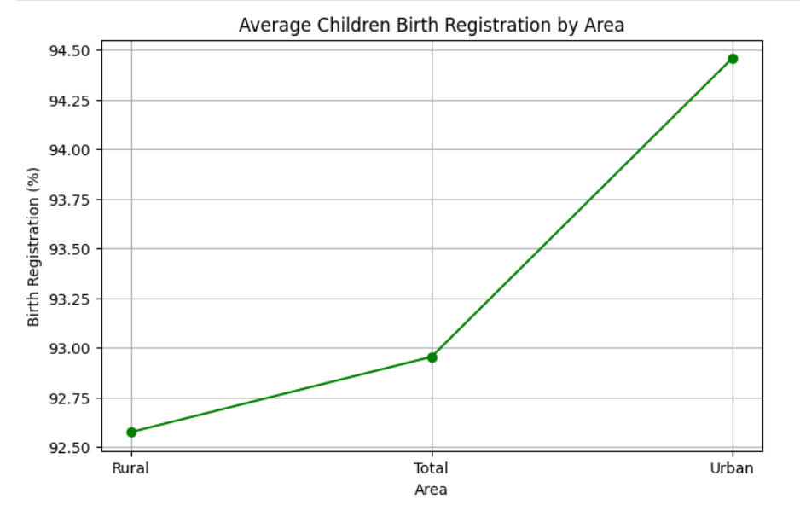
Visual Insights from Initial Analysis
3. Average Children Birth Registration by Area: Birth registration is highest in urban areas (≈94%) and lowest in rural areas (≈92.5%), showing better record practices in urban regions.

Slide 9
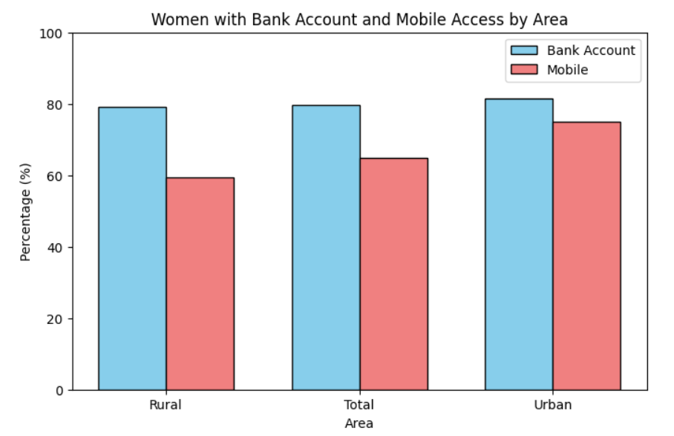
Visual Insights from Initial Analysis
Across all areas, a consistently high percentage (around 80%) of women have a bank account, which is higher than the percentage of women with mobile access. Mobile access is lowest in Rural areas (60%) and highest in Urban areas (75%).

Slide 10
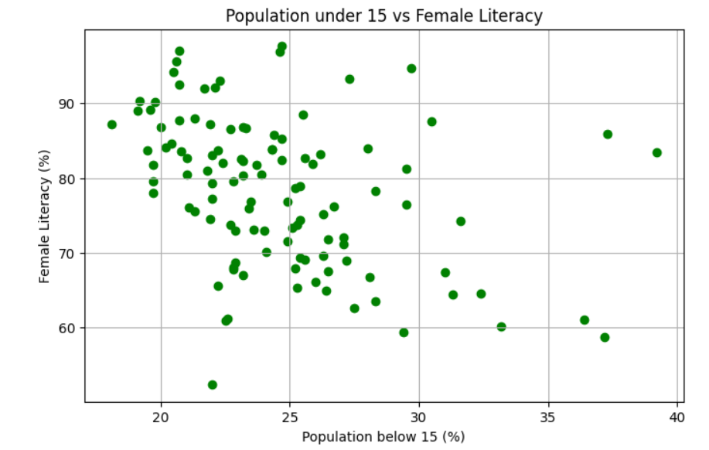
Visual Insights from Initial Analysis
This plot shows a negative correlation between the percentage of population below 15 and female literacy. As the proportion of the young population increases, the female literacy rate generally tends to decrease, though the data points are quite spread out.

Slide 11
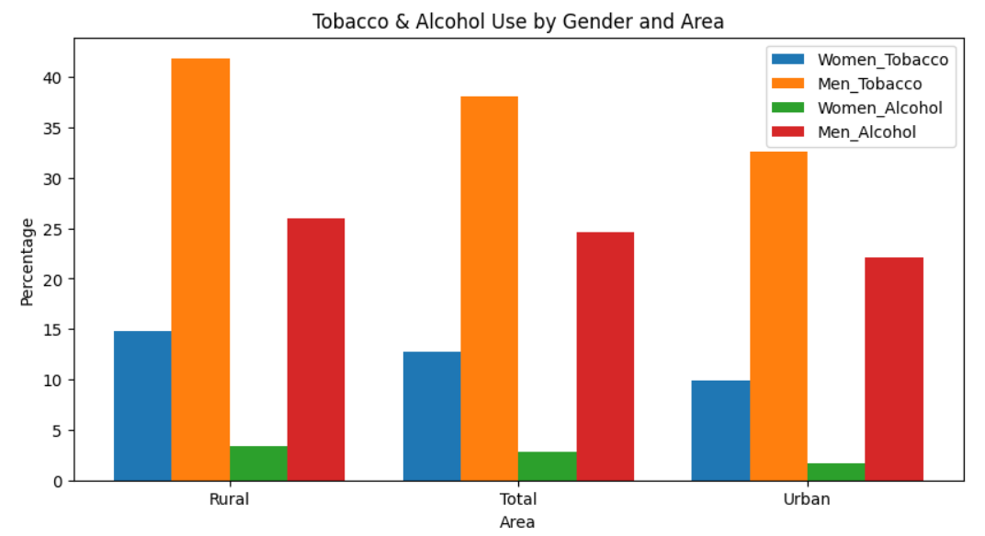
Visual Insights from Initial Analysis
Men show significantly higher use of both tobacco and alcohol than women across all areas. Men's tobacco use is the most prevalent category, peaking in Rural areas (over 40%). Women's alcohol use is the lowest category (under 4%).

Slide 12
Dataset Observations
Urban vs Rural:
Urban areas have higher female literacy (82.5% vs 66.8%) and better access to bank accounts and mobile phones.
Rural areas have higher population below 15 years (28.1% vs 23.1%) and slightly higher sex ratio (1037 vs 985).
Child & Civic Indicators:
Birth registration of children under 5 is slightly higher in urban areas (93.3%) than rural (87.5%). Women’s Empowerment:
Urban women show higher bank/money access (80.9%) and mobile phone usage (69.4%) than rural women.
Men’s access to services is generally higher in both regions.

Slide 13
Dataset Observations
Health & Lifestyle:
Tobacco and alcohol consumption is higher among men in both urban and rural areas.
Urban women show slightly lower tobacco/alcohol use than rural women.Violence &
Safety Indicators:
Rural women report higher spousal violence (31.6% vs 24.2%).
Sexual violence among young women is slightly higher in rural areas.
Conclusion:
The dataset shows clear urban-rural disparities in education, empowerment, health, and social indicators.

Slide 14
Conclusion
The analysis of the NFHS-5 dataset provides a comprehensive understanding of India’s demographic, health, education, and socio-economic indicators across states and regions. The dataset is complete and reliable, enabling a detailed examination of patterns and disparities. Urban areas generally exhibit higher female literacy, better access to bank accounts and mobile phones, and improved child health indicators compared to rural areas. Gender and social patterns reveal regional disparities in sex ratios and higher incidences of spousal and sexual violence in rural areas. Education and women’s empowerment are closely linked, as higher literacy correlates with increased access to financial and communication resources and better menstrual hygiene practices. Health and lifestyle indicators show that men consume more tobacco and alcohol than women, with variations across regions. Overall, the insights from this analysis can guide policymakers and social programs to reduce disparities, improve health and education outcomes, and promote women’s empowerment, demonstrating the value of data-driven decision-making for national development.

